Slide 1
User Interface Design
CO4: Student will be able to design & develop the software solutions for the growth of society
(Source: Pressman, R. Software Engineering: A Practitioner’s Approach. McGraw-Hill, 2005)

Slide 2
Introduction

Slide 3
Background
Interface design focuses on the following
  The design of interfaces between software components
  The design of interfaces between the software and other nonhuman producers and consumers of information
  The design of the interface between a human and the computer
Graphical user interfaces (GUIs) have helped to eliminate many of the most horrific interface problems
However, some are still difficult to learn, hard to use, confusing, counterintuitive, unforgiving, and frustrating
User interface analysis and design has to do with the study of people and how they relate to technology

Slide 4
A Spiral Process
User interface development follows a spiral process
  Interface analysis (user, task, and environment analysis)
    Focuses on the profile of the users who will interact with the system
    Concentrates on users, tasks, content and work environment
    Studies different models of system function (as perceived from the outside)
    Delineates the human- and computer-oriented tasks that are required to achieve system function
  Interface design
    Defines a set of interface objects and actions (and their screen representations) that enable a user to perform all defined tasks in a manner that meets every usability goal defined for the system
  Interface construction
    Begins with a prototype that enables usage scenarios to be evaluated
    Continues with development tools to complete the construction
  Interface validation, focuses on
    The ability of the interface to implement every user task correctly, to accommodate all task variations, and to achieve all general user requirements
    The degree to which the interface is easy to use and easy to learn
    The users' acceptance of the interface as a useful tool in their work

Slide 5
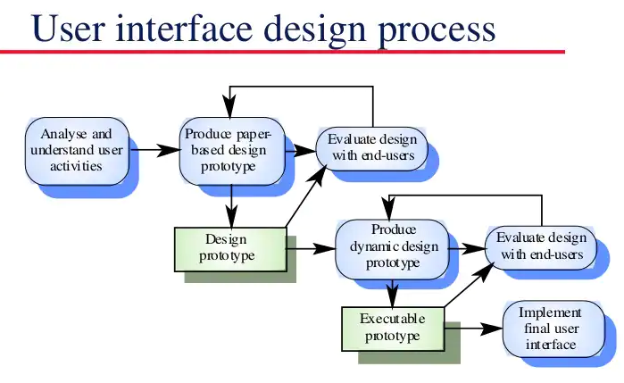

Slide 6
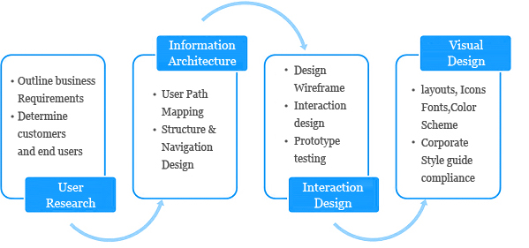
RULES OF USER INTERFACE DESIGN

Slide 7
The Golden Rules of
User Interface Design

Slide 8
The golden rules are divided into three groups:
Place Users in Control
Reduce Users’ Memory Load
Make the Interface Consistent

Slide 9
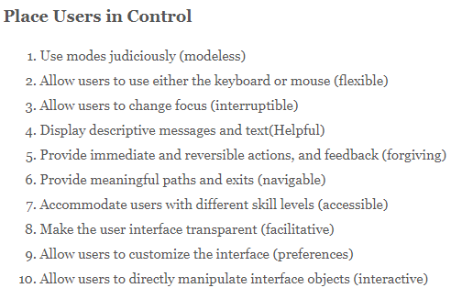
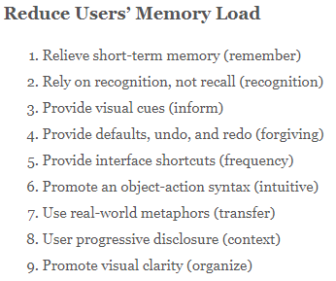
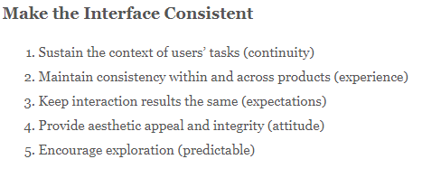

Slide 10
Place the User in Control
Define interaction modes in a way that does not force a user into unnecessary or undesired actions
  The user shall be able to enter and exit a mode with little or no effort (e.g., spell check → edit text → spell check)
Provide for flexible interaction
  The user shall be able to perform the same action via keyboard commands, mouse movement, or voice recognition
Allow user interaction to be interruptible and "undo"able
  The user shall be able to easily interrupt a sequence of actions to do something else (without losing the work that has been done so far)
  The user shall be able to "undo" any action
(More on next slide)

Slide 11
Place the User in Control (continued)
Streamline interaction as skill levels advance and allow the interaction to be customized
  The user shall be able to use a macro mechanism to perform a sequence of repeated interactions and to customize the interface
Hide technical internals from the casual user
  The user shall not be required to directly use operating system, file management, networking. etc., commands to perform any actions. Instead, these operations shall be hidden from the user and performed "behind the scenes" in the form of a real-world abstraction
Design for direct interaction with objects that appear on the screen
  The user shall be able to manipulate objects on the screen in a manner similar to what would occur if the object were a physical thing (e.g., stretch a rectangle, press a button, move a slider)

Slide 12
Reduce the User's Memory Load
Reduce demand on short-term memory
  The interface shall reduce the user's requirement to remember past actions and results by providing visual cues of such actions
Establish meaningful defaults
  The system shall provide the user with default values that make sense to the average user but allow the user to change these defaults
  The user shall be able to easily reset any value to its original default value
Define shortcuts that are intuitive
  The user shall be provided mnemonics (i.e., control or alt combinations) that tie easily to the action in a way that is easy to remember such as the first letter
(More on next slide)

Slide 13
Reduce the User's Memory Load (continued)
The visual layout of the interface should be based on a real world metaphor
  The screen layout of the user interface shall contain well-understood visual cues that the user can relate to real-world actions
Disclose information in a progressive fashion
  When interacting with a task, an object or some behavior, the interface shall be organized hierarchically by moving the user progressively in a step-wise fashion from an abstract concept to a concrete action (e.g., text format options → format dialog box)
The more a user has to remember, the more
error-prone interaction with the system will be

Slide 14
Make the Interface Consistent
The interface should present and acquire information in a consistent fashion
  All visual information shall be organized according to a design standard that is maintained throughout all screen displays
  Input mechanisms shall be constrained to a limited set that is used consistently throughout the application
  Mechanisms for navigating from task to task shall be consistently defined and implemented
Allow the user to put the current task into a meaningful context
  The interface shall provide indicators (e.g., window titles, consistent color coding) that enable the user to know the context of the work at hand
  The user shall be able to determine where he has come from and what alternatives exist for a transition to a new task
(More on next slide)

Slide 15
Make the Interface Consistent (continued)
Maintain consistency across a family of applications
  A set of applications performing complimentary functionality shall all implement the same design rules so that consistency is maintained for all interaction
If past interactive models have created user expectations, do not make changes unless there is a compelling reason to do so
  Once a particular interactive sequence has become a de facto standard (e.g., alt-S to save a file), the application shall continue this expectation in every part of its funtionality

Slide 16
Reconciling Four Different Models

Slide 17
Introduction
Four different models come into play when a user interface is analyzed and designed
  User profile model – Established by a human engineer or software engineer
  Design model – Created by a software engineer
  Implementation model – Created by the software implementers
  User's mental model – Developed by the user when interacting with the application
The role of the interface designer is to reconcile these differences and derive a consistent representation of the interface

Slide 18
User Profile Model
Establishes the profile of the end-users of the system
  Based on age, gender, physical abilities, education, cultural or ethnic background, motivation, goals, and personality
Considers syntactic knowledge of the user
  The mechanics of interaction that are required to use the interface effectively
Considers semantic knowledge of the user
  The underlying sense of the application; an understanding of the functions that are performed, the meaning of input and output, and the objectives of the system
Categorizes users as
  Novices
    No syntactic knowledge of the system, little semantic knowledge of the application, only general computer usage
  Knowledgeable, intermittent users
    Reasonable semantic knowledge of the system, low recall of syntactic information to use the interface
  Knowledgeable, frequent users
    Good semantic and syntactic knowledge (i.e., power user), look for shortcuts and abbreviated modes of operation

Slide 19
Design Model
Derived from the analysis model of the requirements
Incorporates data, architectural, interface, and procedural representations of the software
Constrained by information in the requirements specification that helps define the user of the system
Normally is incidental to other parts of the design model
  But in many cases it is as important as the other parts
Dialog
Box
Task
Agent
Status
Display
Box
File
Transfer
Agent

Slide 20
Implementation Model
Consists of the look and feel of the interface combined with all supporting information (books, videos, help files) that describe system syntax and semantics
Strives to agree with the user's mental model; users then feel comfortable with the software and use it effectively
Serves as a translation of the design model by providing a realization of the information contained in the user profile model and the user’s mental model

Slide 21
User's Mental Model
Often called the user's system perception
Consists of the image of the system that users carry in their heads
Accuracy of the description depends upon the user’s profile and overall familiarity with the software in the application domain

Slide 22
User Interface Analysis

Slide 23
Elements of the User Interface
To perform user interface analysis, the practitioner needs to study and understand four elements
  The users who will interact with the system through the interface
  The tasks that end users must perform to do their work
  The content that is presented as part of the interface
  The work environment in which these tasks will be conducted

Slide 24
User Analysis
The analyst strives to get the end user's mental model and the design model to converge by understanding
  The users themselves
  How these people use the system
Information can be obtained from
  User interviews with the end users
  Sales input from the sales people who interact with customers and users on a regular basis
  Marketing input based on a market analysis to understand how different population segments might use the software
  Support input from the support staff who are aware of what works and what doesn't, what users like and dislike, what features generate questions, and what features are easy to use
A set of questions should be answered during user analysis (see next slide)

Slide 25
User Analysis Questions
Are the users trained professionals, technicians, clerical or manufacturing workers?
What level of formal education does the average user have?
Are the users capable of learning on their own from written materials or have they expressed a desire for classroom training?
Are the users expert typists or are they keyboard phobic?
What is the age range of the user community?
Will the users be represented predominately by one gender?
How are users compensated for the work they perform or are they volunteers?
Do users work normal office hours, or do they work whenever the job is required?
Is the software to be an integral part of the work users do, or will it be used only occasionally?
What is the primary spoken language among users?
What are the consequences if a user makes a mistake using the system?
Are users experts in the subject matter that is addressed by the system?
Do users want to know about the technology that sits behind the interface?

Slide 26
Task Analysis and Modeling
Task analysis strives to know and understand
  The work the user performs in specific circumstances
  The tasks and subtasks that will be performed as the user does the work
  The specific problem domain objects that the user manipulates as work is performed
  The sequence of work tasks (i.e., the workflow)
  The hierarchy of tasks
Use cases
  Show how an end user performs some specific work-related task
  Enable the software engineer to extract tasks, objects, and overall workflow of the interaction
  Helps the software engineer to identify additional helpful features

Slide 27
Content Analysis
The display content may range from character-based reports, to graphical displays, to multimedia information
Display content may be
  Generated by components in other parts of the application
  Acquired from data stored in a database that is accessible from the application
  Transmitted from systems external to the application in question
The format and aesthetics of the content (as it is displayed by the interface) needs to be considered
A set of questions should be answered during content analysis (see next slide)

Slide 28
Content Analysis Guidelines
Are various types of data assigned to consistent locations on the screen (e.g., photos always in upper right corner)?
Are users able to customize the screen location for content?
Is proper on-screen identification assigned to all content?
Can large reports be partitioned for ease of understanding?
Are mechanisms available for moving directly to summary information for large collections of data?
Is graphical output scaled to fit within the bounds of the display device that is used?
How is color used to enhance understanding?
How are error messages and warnings presented in order to make them quick and easy to see and understand?

Slide 29
Work Environment Analysis
Software products need to be designed to fit into the work environment, otherwise they may be difficult or frustrating to use
Factors to consider include
  Type of lighting
  Display size and height
  Keyboard size, height and ease of use
  Mouse type and ease of use
  Surrounding noise
  Space limitations for computer and/or user
  Weather or other atmospheric conditions
  Temperature or pressure restrictions
  Time restrictions (when, how fast, and for how long)

Slide 30
User Interface Design

Slide 31
Introduction
User interface design is an iterative process, where each iteration elaborate and refines the information developed in the preceding step
General steps for user interface design
  Using information developed during user interface analysis, define user interface objects and actions (operations)
  Define events (user actions) that will cause the state of the user interface to change; model this behavior
  Depict each interface state as it will actually look to the end user
  Indicate how the user interprets the state of the system from information provided through the interface
During all of these steps, the designer must
  Always follow the three golden rules of user interfaces
  Model how the interface will be implemented
  Consider the computing environment (e.g., display technology, operating system, development tools) that will be used

Slide 32
Interface Objects and Actions
Interface objects and actions are obtained from a grammatical parse of the use cases and the software problem statement
Interface objects are categorized into types: source, target, and application
  A source object is dragged and dropped into a target object such as to create a hardcopy of a report
  An application object represents application-specific data that are not directly manipulated as part of screen interaction such as a list
After identifying objects and their actions, an interface designer performs screen layout which involves
  Graphical design and placement of icons
  Definition of descriptive screen text
  Specification and titling for windows
  Definition of major and minor menu items
  Specification of a real-world metaphor to follow

Slide 33
Design Issues to Consider
Four common design issues usually surface in any user interface
  System response time (both length and variability)
  User help facilities
    When is it available, how is it accessed, how is it represented to the user, how is it structured, what happens when help is exited
  Error information handling (more on next slide)
    How meaningful to the user, how descriptive of the problem
  Menu and command labeling (more on upcoming slide)
    Consistent, easy to learn, accessibility, internationalization
Many software engineers do not address these issues until late in the design or construction process
  This results in unnecessary iteration, project delays, and customer frustration

Slide 34
Guidelines for Error Messages
The message should describe the problem in plain language that a typical user can understand
The message should provide constructive advice for recovering from the error
The message should indicate any negative consequences of the error (e.g., potentially corrupted data files) so that the user can check to ensure that they have not occurred (or correct them if they have)
The message should be accompanied by an audible or visual cue such as a beep, momentary flashing, or a special error color
The message should be non-judgmental
  The message should never place blame on the user
An effective error message philosophy can do much to improve the quality of an interactive system and will significantly reduce user frustration when problems do occur

Slide 35
Guidelines for Error Messages
The message should describe the problem in plain language that a typical user can understand
The message should provide constructive advice for recovering from the error
The message should indicate any negative consequences of the error (e.g., potentially corrupted data files) so that the user can check to ensure that they have not occurred (or correct them if they have)
The message should be accompanied by an audible or visual cue such as a beep, momentary flashing, or a special error color
The message should be non-judgmental
  The message should never place blame on the user
An effective error message philosophy can do much to improve the quality of an interactive system and will significantly reduce user frustration when problems do occur

Slide 36
Questions for Menu Labeling and Typed Commands
Will every menu option have a corresponding command?
What form will a command take? A control sequence? A function key? A typed word?
How difficult will it be to learn and remember the commands?
What can be done if a command is forgotten?
Can commands be customized or abbreviated by the user?
Are menu labels self-explanatory within the context of the interface?
Are submenus consistent with the function implied by a master menu item?

Slide 37
User Interface Evaluation

Slide 38
Design and Prototype Evaluation
Before prototyping occurs, a number of evaluation criteria can be applied during design reviews to the design model itself
  The amount of learning required by the users
    Derived from the length and complexity of the written specification and its interfaces
  The interaction time and overall efficiency
    Derived from the number of user tasks specified and the average number of actions per task
  The memory load on users
    Derived from the number of actions, tasks, and system states
  The complexity of the interface and the degree to which it will be accepted by the user
    Derived from the interface style, help facilities, and error handling procedures
(More on next slide)

Slide 39
Design and Prototype Evaluation (continued)
Prototype evaluation can range from an informal test drive to a formally designed study using statistical methods and questionnaires
The prototype evaluation cycle consists of prototype creation followed by user evaluation and back to prototype modification until all user issues are resolved
The prototype is evaluated for
  Satisfaction of user requirements
  Conformance to the three golden rules of user interface design
  Reconciliation of the four models of a user interface

